Slide 1
Interhall Hackathon ‘22
Raffles x KEVII x Eusoff x Kent Ridge

Slide 2
Table of contents
Introduction
Problem Statement
01
02
Rules and Judging
Timeline
03
04

Slide 3
01
Introduction

Slide 4
Introduction
The Interhall Hackathon is a hackathon organized jointly by 4 halls of NUS: Raffles, Eusoff, Kent Ridge and King Edward VII.
It was built upon the idea of sharing knowledge between the different halls about ideas on how to improve hall life for residents.

Slide 5
Problem Statement
We all enjoy staying on campus, but there’s so many things to experience that it can be overwhelming at times. Find a problem that you think impacts residents in your hall, and create something that will make it better!
This is an open ended question, feel free to find any problem and build anything that fits!

Slide 6
Opening Address
Enter

Slide 7
Rules
Enter

Slide 8
Rules
Participants are expected to form teams up to 4 per group or work solo should they prefer to do so.
Please make sure that your profile bio has the following details: Real Name, Hall, Year and Major. This is so that we are able to identify you and pass you your prizes if you win.
Participants are only allowed to join only one project. Participants who join multiple projects risk disqualification.
Warning: Participants may be disqualified if they do not follow the rules.

Slide 9
Judging
Enter

Slide 10
Judging
Judging will be done similar to that of a science fair style, judges will come by each table and the team will be given some time to present their projects.
Each team will have:
3 min presentation time
5 min Q&A time
2 min judging time

Slide 11
Judging Criteria
Enter

Slide 12
Judging Criteria
Component | Consideration | Improving (0-3) | Good (4-7) | Excellent (8-10)
Relevance (20%) | How well does the hack align with the chosen theme and problem statement? | Application displayed minimal alignment to the problem statements | Application displayed relevant alignment to the problem statements | Application has succeeded in being highly aligned with the problem statements
Innovation (20%) | Uniqueness and creativeness of the hack (Demonstrate these qualities: inspiring, novel, persuasive, fresh motivating, engaging, etc.) | Application displayed themes that have been commonly proposed before and does not showcase creativity | Application displayed themes that are new and shows a level of sophistication befitting of the problem statement | Application displayed a brand new theme that is one of a kind and fresh
Viability (30%) | How much prospective value does the hack possess, how feasible would it be | Overall, the solution is not feasible to implement | The application shows potential value and it is feasible to implement | Overall, there is high value in the application and it can be implemented almost immediately without issues.
Usability (20%) | How polished and resolved the hack is, as well as the integration of aesthetic/graphic and functions. How user friendly is the interface? How difficult was it to utilise the advertised features? | Overall graphics are detached from function, navigating around the app requires inference. The user interface is unfriendly and it is difficult to navigate around | Overall graphics tally with the function, some integration with usability- functions somewhat flow from one to the other but requires more effort. The user interface is decent enough for an application but more improvement needed for implementation | Overall graphics and function are fully integrated with usability- portrays what the app is meant to do. Navigation around the app is intuitive as functions flow from one to the other.
Technical Implementation (10%) | How effective is the technical approach and implementation of the product or solution | Technical approach is inappropriate or ineffective for the product. Clear logical errors and/or major bugs | Appropriate technical approach, is operable with minor bugs | Finesse in terms of software/hardware usage with little to no bugs

Slide 13
Timeline
Enter

Slide 14
Timeline - 5 Dec
Time | Event | Location
9.00AM | Opening Ceremony | Raffles Hall Comm Hall
10.00AM | Event Begins | Comm Hall/ Upper Lounge/ Wherever you feel comfortable!
6.00PM | Dinner (for RH Participants) | Comm Hall

Slide 15
Timeline - 6 Dec
Time | Event | Location
11.00AM | Submission Close | All participants to be back in Comm Hall
12.00PM | Judging begins
1.00PM | Consolidation of results
3.30PM | Announcement of Winners and Prize Presentation | Comm Hall
4.00PM | Performance by RHockers | Comm Hall
4.30 | Closing Ceremony | Comm Hall

Slide 16
Closing Address
Enter

Slide 17
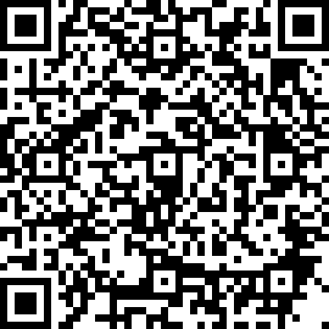
Feedback Form

